Slide 1
Internship Documentation
Trading R&D Internship
Jan - May 2022
By Bervyn Wong

Slide 2
Contents
CP Global’s vision - Onboarding process
Macroeconomic sentiment, forecasting 10Y bond yields (nowcast_strategy)
Bloomberg terminal training (Undocumented)
CPGI’s Quant strategy: CTA Momentum - Production Review
Data verification for researcher’s work (Undocumented)

Slide 3
Understanding the firm
Trading R&D Internship (Jan-May 2022)
Global macro principles

Slide 4
Global macro strategy
See the forest, not just the trees.
Adapted from Bloomberg article ‘Your guide to the many flavors of quant investing’
This approach trades across asset classes and countries and relies upon macroeconomic principles.
Using data such as inflation, unemployment and consumer spending, the strategy attempts to build a set of rules that govern the relationship between economic cycles and market movements.
Typical holding period: > 1 month
Example: To capture the spread between different currency rates, sell low-interest-rate currencies and buy higher-interest-rate assets. This is called a carry trade.
Why it works: It benefits from diversification across asset classes. It’s often billed as a risk-mitigating strategy, participating on the upside but protected on the downside.
Other firms that have adopted this strategy:
QS Investors, Quest Partners LLC, Winton Capital Management

Slide 5
Task 1 - Macro sentiment & forecasting
Trading R&D Internship (Jan-May 2022)
nowcast_strategy

Slide 6
Macroeconomic factors shaping market conditions
4 factors shaping market trends:
Govt policies
International transactions
Speculation, Expectation
Supply & Demand
Economic growth (GDP)
Unemployment
Inflation
Interest Rates
Exchange rates

Slide 7
Principles of strategic innovation, R&D
Refer to ‘whitetiger’ repository (PyCharm)
Understanding R&D process of the firm
Data access
Data Transformation
Signal Generation (decision to buy/sell, taking action)
Plotting for data visualisation
Paper trades + review
Live trades
Understanding the independent variables being input into the regression model, creating the predicted output (y_hat)

Slide 8
Objectives of the script
Concept
Sunday data - reviewed on Monday - projected forecast for upcoming week
Forecast US 10-Year Govt Bond yields to have a better evaluation of market conditions
Adoption of a forward-thinking principle
Run multivariate regression analysis to determine a predictive output for interest rates
Attain data files, data sets and plot on charts to compare with actual interest rates (TradingView)

Slide 9
Variables
Creating the Attribution model
Get csv files
Access data files
Weekly refreshed data (pool from BBG on excel)
Processing data files -> logger
Load on to input csv files
Apply rolling regression (data transformation)
Transform stationary data
Define thresholds [-1,0,1]
Exogenous variables - values determined outside of model
Define additional statistical parameters
Define metrics (output, p-value, etc.)
Save back forecast
Save to csv/excel
Independent:
Gold futures
Copper futures
S&P 500 E-mini futures
CBOE Volatility index (VIX)
JPY currency (safe haven)
EUR currency
10Y TIPS yield (inflation index)

Slide 10
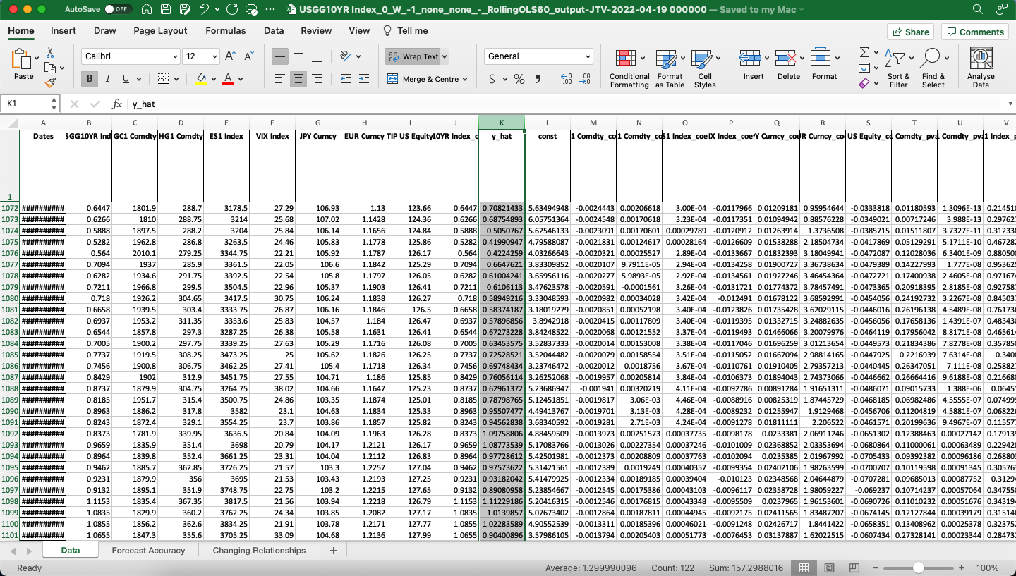
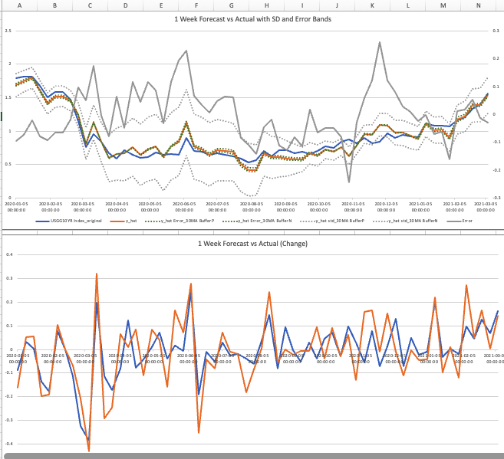
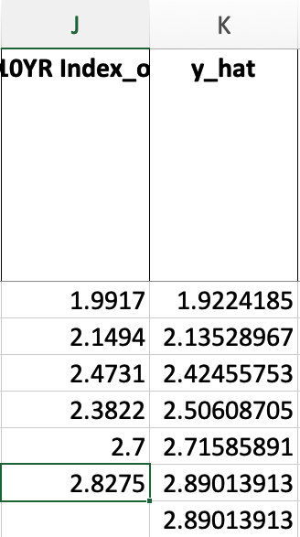
Illustration of output models - Forecast Accuracy
~ Actual vs Predicted output for US10Y bond ~

Slide 11
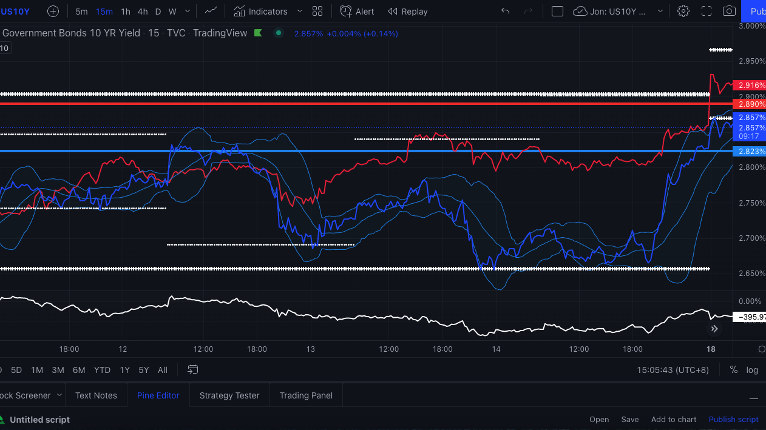
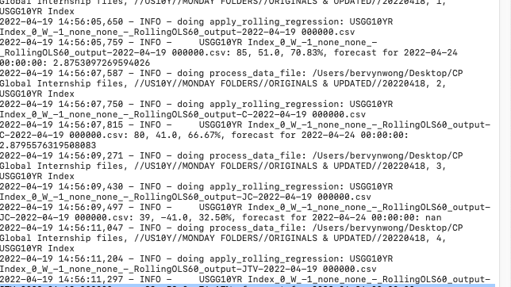
Charting on TradingView
Every Monday, a new weekly comparison plot is to be produced
Actual vs Forecast Accuracy ratio
AvF

Slide 12
Task 2 - CPGI Quant Strategy (Production Review)
Trading R&D Internship (Jan-May 2022)
CTA Momentum Strategy

Slide 13
Time log of contents
Weekly reviews
Workflow Process
Problems encountered
Intuitions developed
Solutions
Learning points
Final reflections on script

Slide 14
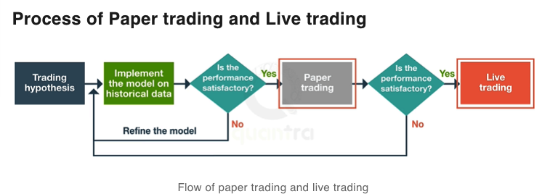
Flow of Strategic Development

Slide 15
Week 1 - Brainstorming
Task - Development of Commodities Trading Advisor (CTA) strategy
Trend-following characteristics (vs market-neutral?)
CTA Global Macro fund
Focus of asset classes: Equity indexes & Commodities
A trading style that attempts to capture profits through analysis’s momentum in a particular direction
Only 2 market regimes: Trend or Range

Slide 16
Week 1 - Brainstorming
Look out for trends
Value vs Momentum
Value - Buy low, sell high
Momentum - Buy high, sell higher
- when trend↑, go LONG
- when trend ↓, go SHORT
- make use of technical indicators to identify trends: RSI, MACD
- identify trend directions, generate trend signals
- *** trend-following looks at ABSOLUTE returns

Slide 17
Why trends occur
Behavioural biases
Slow reaction to uncertainty/information
Institutional investors react quicker than retail investors, and make larger moves in the market, which accounts for extreme short-term price changes resulting in big swings/volatility
Dispersion in investor beliefs

Slide 18
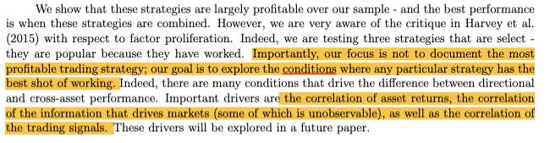
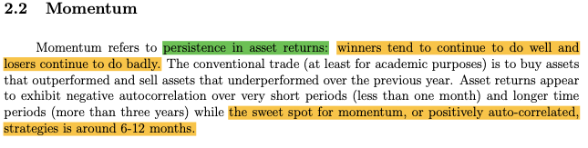
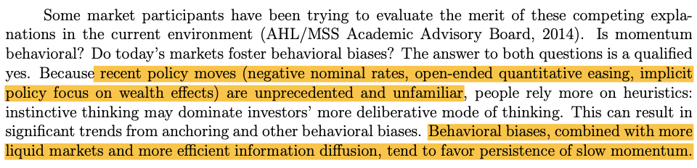
Research paper ideas

Slide 19
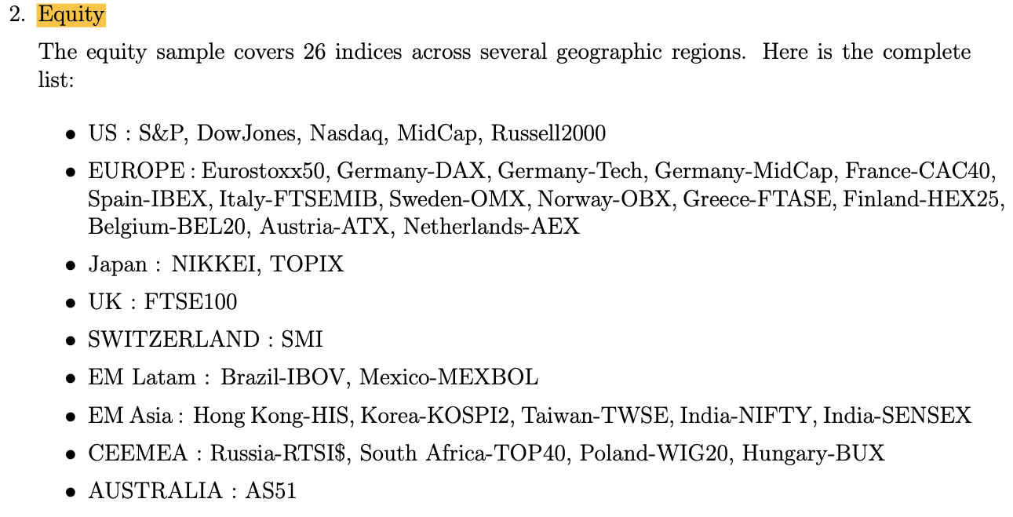
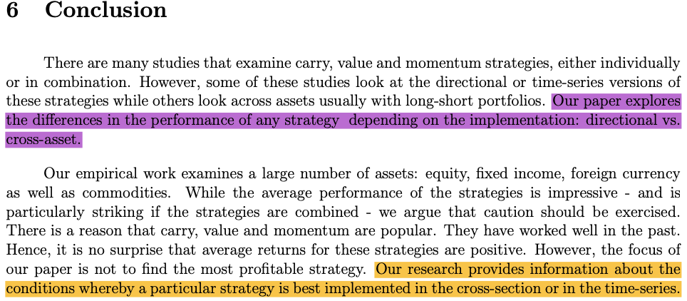
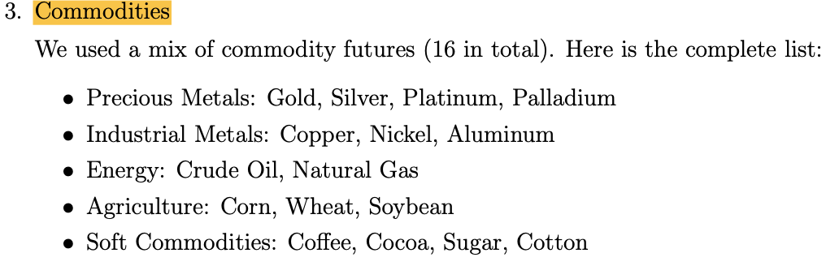
Research paper ideas - cont
~ Excerpts from “Dissecting Investment Strategies in the Cross Section and Time Series” (2015)

Slide 20
Week 2 - Mapping ideas
Process:
Data query on prices
Transform data
Signal generation (buy/sell indicators)
Trade PnL
Cumulative PnL (absolute returns)

Slide 21
Week 2
Key concepts
Clearly define your universe of assets
Set fixed timeframe
Define Backtest period (sample/training period)
Define out-of-sample/testing period
Strategy metrics, e.g. win rate, PnL, etc.
Purpose of plots: to show the necessary elements to understand when the trade is done

Slide 22
Week 3 - Backtesting
Backtesting
How many assets? Index? Bonds? Sector-based equities?
Individual weightage?
Avg. backtesting period? 1Y/10Y/Intraday?
Performance indicators
Cumulative returns
Sharpe Ratio
Max Drawdown
Win rate

Slide 23
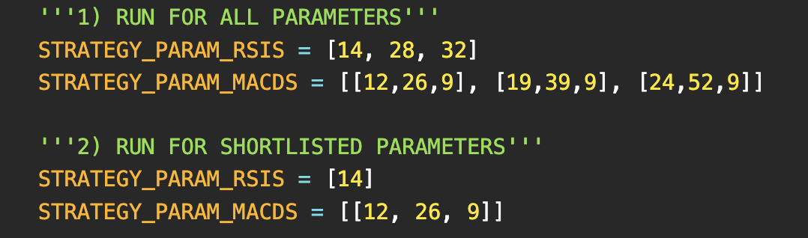
Week 3 - Parameters
** Which combinations of parameters give the best strategy?
Answer: research has shown there is no comparable difference in effectiveness, hence we choose a standard few to begin with

Slide 24
Weeks 4-5: Script development
Primarily coding misconceptions cleared up
Constant refinement of code
Limitations/ Questions asked:
When an uptrend begins to occur, do we buy/sell? that is the qn many traders today are best trying to answer
Contradicting factors between RSI & MACD? MACD = trend filter, RSI = countertrend normaliser
Acceleration of divergence between fast & slow mA - How do we take advantage of this?

Slide 25
Weeks 4-5: Parameter definitions
No. of assets: 20 - US highest market cap equities
my_asset_list = ['AAPL', 'MSFT', 'GOOGL', 'BRK-B', 'AMZN', 'TXN', 'NVDA', 'HON', 'NTES', 'ASML', 'AMAT', 'CSCO', 'PEP', 'COST', 'ADBE', 'CMCSA', 'INTC', 'AZN', 'QCOM', 'NFLX']
In-sample: 01-01-2008 to 12-31-2018, 1Y Periodicity (10 years)
Out of sample: 01-01-2019 to 12-31-2021, 1Y Periodicity (3 years)
Strategy modes:
RSI ([14], [28], [32])
MACD ( [12,26,9], [19,39,9], [24,52,9] )
Output files:
Search data + shortlisted (top 3 highest PnL) plots, yearly, for each strategy - total 6x20=120 plots
Search data (raw trades + ranked results)
Derived data (total PnL)
Shortlisted (raw trades + ranked results)

Slide 26
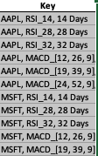
Weeks 4-5: Technical notes
PnL dataframe - recording of each individual trade
Using index as the ‘key’ - ASSET_STRATEGY_PARAM
Concatenation of dataframes using common key index, e.g. ‘AAPL_RSI_14’
* Finding the ‘key’ that is unique_column and use that as a bridge to link all the DataFrames together
We then take this as an index (reset_index), so when searching for total PnL, it can be grouped together, year after year

Slide 27
Week 6 - Reviewing trade PnL
Individual trade to mark out PnL at given timestamp (dataframe index, i.e. time)
Data points, i.e. raw data, are CRUCIAL to capture
So can use these findings for many other interpretations for metrics like win rate and max drawdown
For each trade log captured, append to trade view empty list (check variables in python script)
Once trade view is consolidated, concatenate and convert in a full DataFrame
Important misconception *** - PnL is an ABSOLUTE value, not rolling/relative

Slide 28
Week 7 - Grid Search
Data has been trained, now move on to shortlisting process
Shortlist criteria:
key unique columns delivering top 3 highest total PnL
They are:
Assets (tickers): AZN, QCOM, CSCO
Strategy_mode: RSI
Parameter: 14-day lookback period
Coding aspect:
Drafted out more folder paths and set parameters for the shortlisted results (local storage)
Selection review
You would expect to have shortlisted stocks from sectors like tech, as they bring highest growth potential, thus greatest momentum
In reality, what came out were stocks from other sectors that don’t usually bring highest average returns

Slide 29
Week 7 - Grid Search
Construction of dataframes and shortlisted raw trades/ PnL results
Think in terms of:
1) Data Structure
2) Procedurally
- Win rate is meant to be calculated INTO each unique key
- Consolidated DataFrame: each year’s PnL -> each year’s win rate
- PnL * Win Rate Plot (top 3 unique keys)

Slide 30
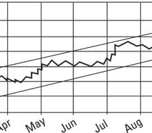
Week 8 - Review of strategy_plots
Limitations/Problems encountered
Multiple jagged parts (shows mean-reverting properties, rather than smoother trend-following), resulting in unnecessary losing trades
Clear trend, but signal shows counter-trend action
Leads to sustained losses
*Bear in mind that RSI is a normalised, COUNTER-TREND based indicator

Slide 31
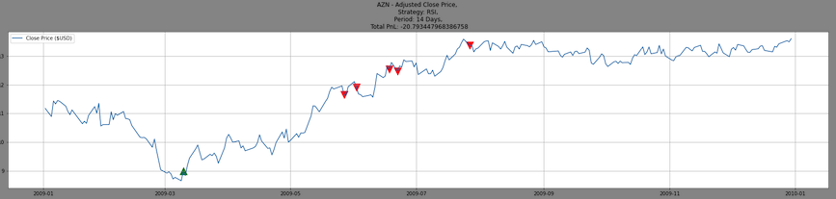
Week 8 - Review of strategy_plots
Examples: Case Studies upon analysis - AZN (2009-2010, RSI-14)

Slide 32
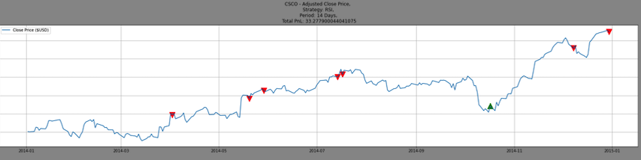
Week 8 - Review of strategy_plots
Examples: Case Studies upon analysis - CSCO (2014-2015, RSI-14)

Slide 33
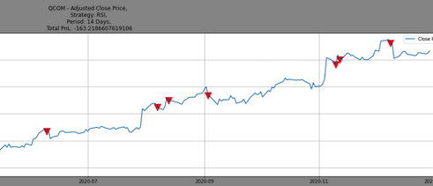
Week 8 - Review of strategy_plots
Examples: Case Studies upon analysis - QCOM (2020-2021, RSI-14)

Slide 34
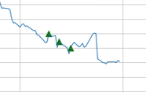
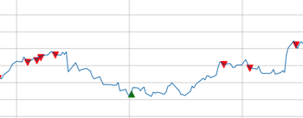
Week 8 - Review of strategy_plots
Examples: Case Studies upon analysis

Slide 35
Week 8 - Review of strategy_plots
Possible Solutions
Using MACD as a trend/noise filter, to identify general trends and negate unsuccessful RSI trades
Add 3rd panel to plots
MACD: identify trends
RSI: performs well in sideways market
Zoom into MACD indicator, evaluate cutoff for
Trend
Counter-trend
Trade conditions
RSI + MACD countertrend
Cross-section Ranking

Slide 36
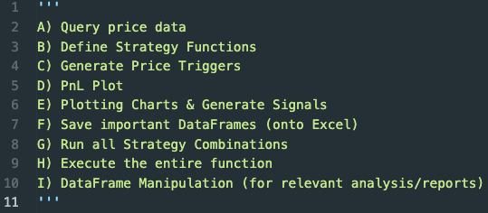
Final Consolidations
Workflow of Python script

Slide 37
Final Takeaways
This is a trend-following momentum strategy
However…
After grid searches, the best shortlisted results came from an indicator that has counter-trend properties (???)
No indicator is the perfect strategy, but it gives insights of what works and what does not, after many attempts of optimisation

Slide 38
~ End of Script Development ~
Trading R&D Internship
17 Jan-1 May 2022
By Bervyn Wong

